Slide 1

American Writers

Slide 2
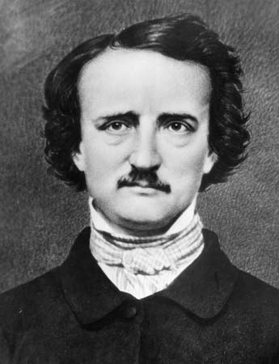
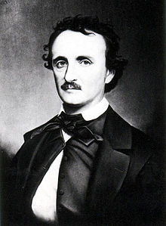
Edgar Allan Poe
19.1.1809(Boston)
Orphan
Poet,editor,literary critic,novelist
Genre: fantastic,mystical
:founder of the detective and horror
part of the American Romantic Movement
Depression, alcohol, drugs
7.10.1849(Baltimore)

Slide 3
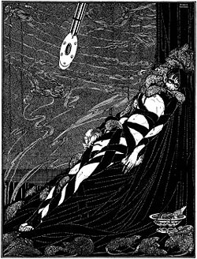
Tale: The Pit and the Pendulum
short story
first published in 1842
about the torments endured by a prisoner of the Spanish Inquisition
Adaptations: 1903-Le Puits et le pendule
1913-The first English language adaptation by Alice Guy-Blaché
1983-The Pendulum, the Pit and Hope by czech surrealist Jan Švankmajer

Slide 4
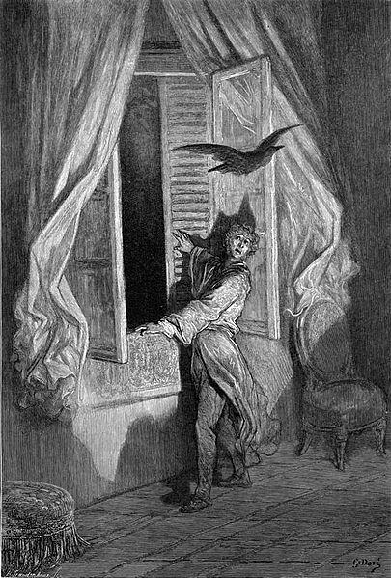
Tale: The Raven
Poem
first published in January 1845
one of the most famous poems ever written
supernatural atmosphere
About talking raven's mysterious visit to a distraught lover, tracing the man's slow descent into madness
it didn´t bring him much financial success

Slide 5


STEPHEN KING
21. 9.1947(Portland)
1959-Dave's rag
Novelist, short story writer, actor, film director
Genre: horror, science fiction, fantasy, drama
Directing:Maximum Overdrive (1985)
Many adaptations
Over 350 million copies

Slide 6
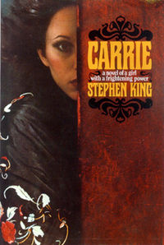
Tale: Carrie
American horror novel
King's first published novel(1974)
About a shy high-school girl, who uses her newly discovered telekinetic powers to exact revenge on those who tease her.
One of the most frequently banned books in United States schools
Adaptations: 1976 -feature film
1988-Broadway musical
1999-feature film sequel(The Rage: Carrie 2)
2002-television movie

Slide 7
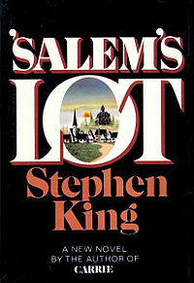
Tale: Salem's Lot
Horror fiction novel
His second published novel(1975)
About a writer who returns to the town where he lived as a boy to discover that the residents are all becoming vampires
Nominated for the World Fantasy Award for Best Novel
Adaptations: 1979-Television miniseries(Salem's Lot )
1987-Film and in-name only sequel to 1979 miniseries.
1995-Radio drama(Salem's Lot)
2004-Television miniseries(Salem's Lot)

Slide 8
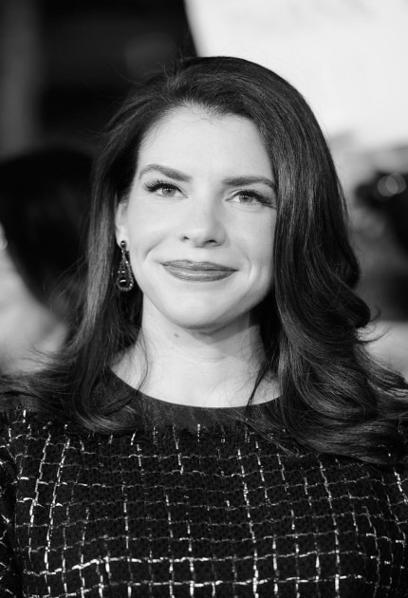

Stephenie Meyer
24.12.1973(Hartford)
Novelist, producer
Genre: vampire romance, science fiction
The biggest selling author in America (2008,2009)
Annual earnings: $40 million
3 sons

Slide 9

Tale: The Host
Science fiction,romance novel
Published on May 6,2008
About an alien race, called Souls, which takes over the Earth and its inhabitants
The book describes one Soul's predicament when the mind of its human host refuses to cooperate with her takeover
"Best Books of May"

Slide 10
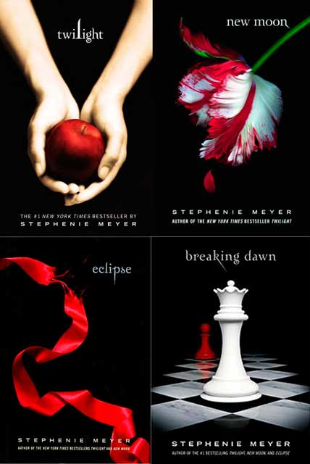
TALE: The Twilight saga
Series of four vampire-themed fantasy romance novels
Published: 2005-2008
About the life of Isabella Swan, a teenage girl who moves to Forks, and falls in love with a vampire named Edward Cullen
translations into 38 different languages
Adaptations: 2008-Twilight
2009-New Moon
2010-Eclipse
2011/2012-Breaking Dawn

